Slide 1

1.3.1 Lecture slides with audio
Grand growth narrative
<https://github.com/braddelong/public-files/blob/master/econ-115-module-1-lecture-3.1-grand-narrative-%23tceh.pptx>
Inequality & humanity
What has gone badly wrong
Slouching towards utopia?
Link
Link

Slide 2
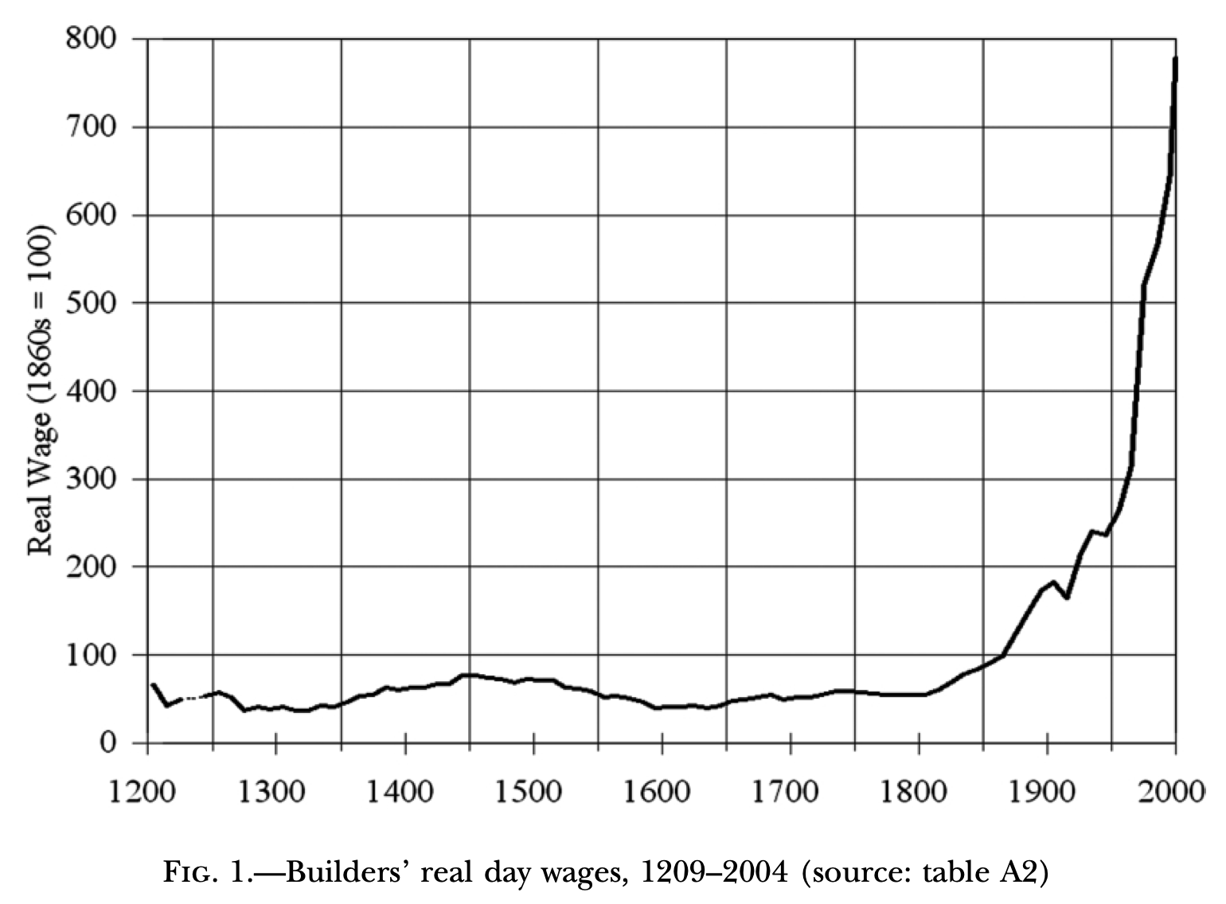
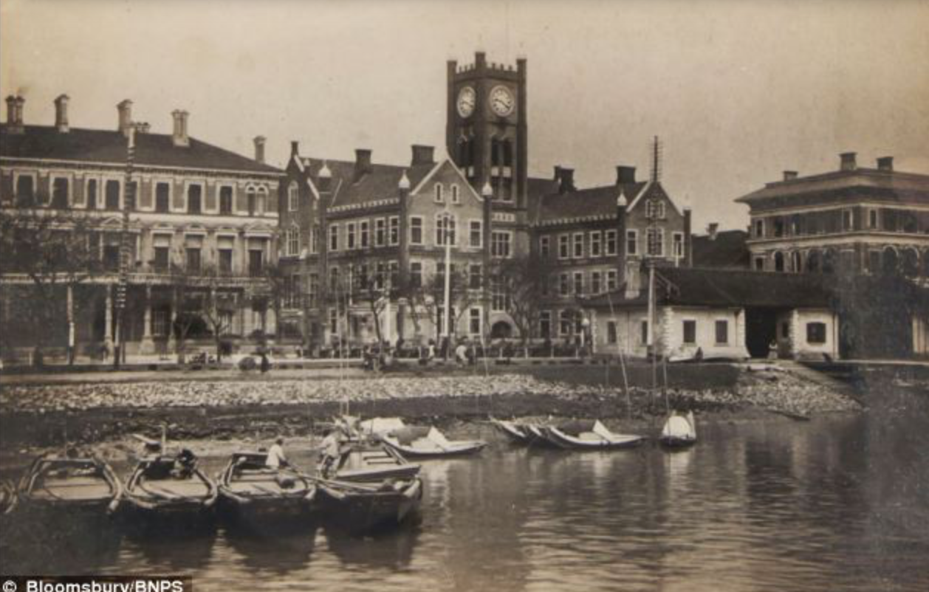

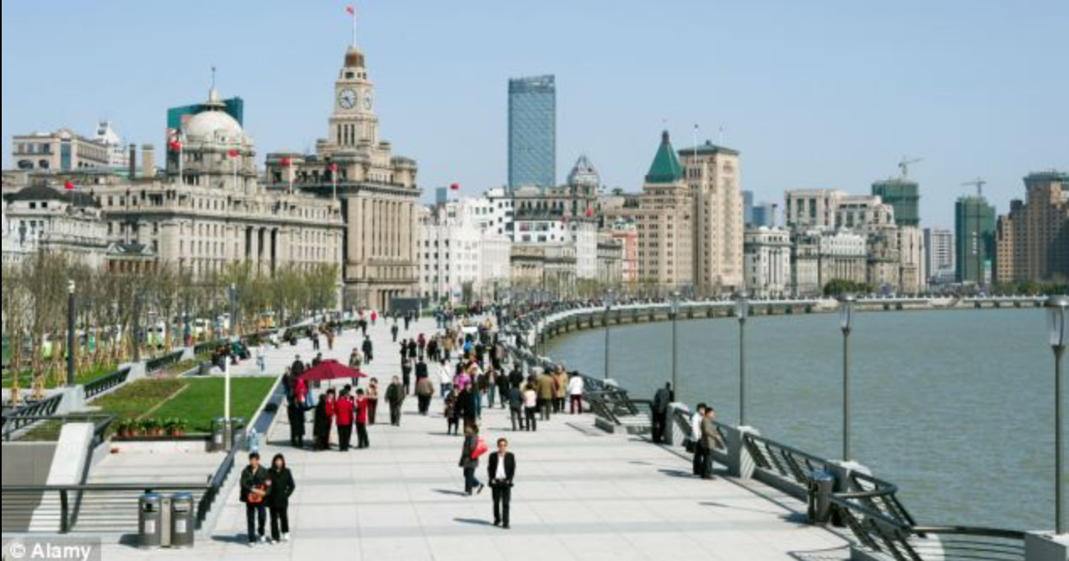
Lecture: 1.3.1. Grand Narrative
Five lecture components:
The Grand Narrative
Themes 1-3: History economic, wealth explosion, technological cornucopia
Themes 4-6: Feminism, demography, inclusion
Themes 7-9: Tyrannies, wealth gulfs, mismanagement
Slouching Towards Utopia?
Orienting yourself:
When do I say the Long 20th Century really started?
Why then?
When do I say the Long 20th Century really ended?
Why then?
What was the typical human standard of living back in 1870?
What is the typical human standard of living today?
Is there a typical human standard of living today?
Is the world today a utopia?
Is greater San Francisco today a utopia?
4:15 of audio in this slide; 21:00 in this slide group
Notes:
Good morning, good afternoon, or good evening. I’m Brad DeLong. And this is my economic history of the long twentieth century.
At the top on the right hand of this slide we have the real—that is, inflation and deflation adjusted, so that we do not get confused by changes in the purchasing power of money—wages of people working in the construction trades in England from 1200 to the present. This real wage series has a somewhat shaky basis. We know how much in money terms construction workers were paid. We know how much in money terms the things they bought cost. We do not know as much as we would like about how long the working day was. And we are pretty much at sea when it comes to the question of how we incorporate into our index the fact that people today can buy many, many, many more and different useful things than people could buy back in 1300. This graph almost surely makes the upward pointing blade of the hockey stick at the right hand side of the figure a lot smaller than a properly representative graph would show.
In the middle of the right hand side of the slide we have a picture of the Shanghai waterfront in I think it is the 1880s: a view of the then British concession. At the bottom we have the Shanghai waterfront earlier in this decade. Quite a difference, no?
The contrast between these two pictures is the on the ground reality that corresponds to the different height of the line on the graph in the 1800s and today. By contrast with all previous human civilizations, our knowledge of technology and of human organization makes us rich beyond even the imaginings of the fables that people told in the past.
And the bulk of the transformation from the poor, largely subsistence human world of the past to our prosperous–potentially prosperous, at least–world of today was accomplished in the long 20th century from 1870 to 2016.
That explosion of human wealth driven forward by the extraordinary advance of knowledge in how to use technologies to manipulate the matter and energy of nature, and to organize humans productively, is the core of my Grand Narrative of the economic history of the long 20th century.
In telling this grand narratives we will find ourselves visiting and revisiting nine different themes. Three of these themes will focus on engineering and economics in the forms of technology, accumulation, and production; three will focus on sociology and economics in the forms of gender, ethnicity, and social roles; and three will focus on politics and economies in the forms of tyranny, property control, and economic system governance and mismanagement.
And then there is the question of how we assess this historical process. If we frame things by supposing that the people who inhabited the world in the long 20th century had the historical task of carrying the baton toward utopia, how well did they do?
By now you should have read at least the first two chapters of my manuscript on the economic history of the long 20th century.
But if you read it passively, I want you to go back and do it again, this time reading it actively.
How do you know if you read it passively? If you cannot answer the questions underneath the “orienting yourself” heading on the left side of the slide, go back and read it again—this time asking yourself questions as you read, and answering them, and also asking me questions, and imagining in your mind’s eye and ear what my answers would be.

Slide 3
Orientation
Chronology:
When do I say the Long 20th Century really started? 1870
Why then? The third watershed—the third step-up in the global pace of economic growth—globalization, and the start of the American century
When do I say the Long 20th Century really ended? 2016.
Why then? Three reasons: (1) end of the American century, slowdown in global north growth, failure of economic management.
Quantities:
What was the typical human standard of living back in 1870? Perhaps $4/day—$1300/year
What is the typical human standard of living today? Perhaps $35/day—$12000/year
Is there a typical human standard of living today? Maybe not: inequality is much greater than it was in 1870, and even more so in 1800. A global north of 800 million with a typical standard of living of $50000/year—$150/day; a global south of 6.8 billion with a typical standard of living of $7000/year—$20/day
Is the world today a utopia? Definitely not…
Is greater San Francisco today a utopia? What do you think?
2:15 of audio in this slide
Notes:
Well, you don’t have to rely purely on your imaginings in order to figure out what my answers to the orienting questions are. I am right here. Here are the questions, and my answers.
When do I say the Long 20th Century really started? 1870.
Why then? The third watershed—the third step-up in the global pace of economic growth—globalization, and the start of the American century.
When do I say the Long 20th Century really ended? 2016.
Why then? Three reasons: (1) end of the American century, (2) slowdown in global north growth, (3) failures of economic management.
What was the typical human standard of living back in 1870? Perhaps $4/day—$1300/year
What is the typical human standard of living today? Perhaps $35/day—$12000/year
Is there a typical human standard of living today? Maybe not: inequality is much greater than it was in 1870, and even more so in 1800. A global north of 800 million with a typical standard of living of $50000/year—$150/day; a global south of 6.8 billion with a typical standard of living of $7000/year—$20/day
Is the world today a utopia? Definitely not…
Is greater San Francisco today a utopia? What do you think?
Do you think my answers are right? Or, rather: which of my answers do you think are wrong, and why do you think so?

Slide 4
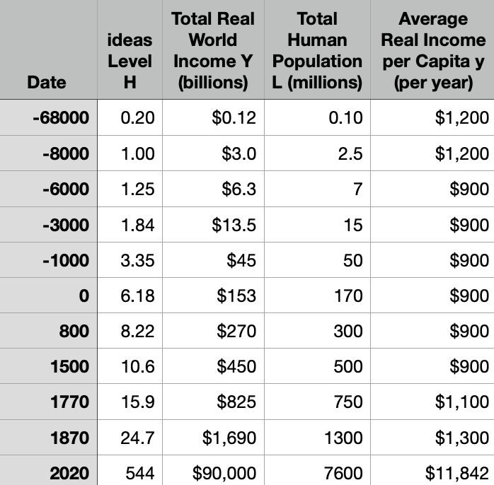
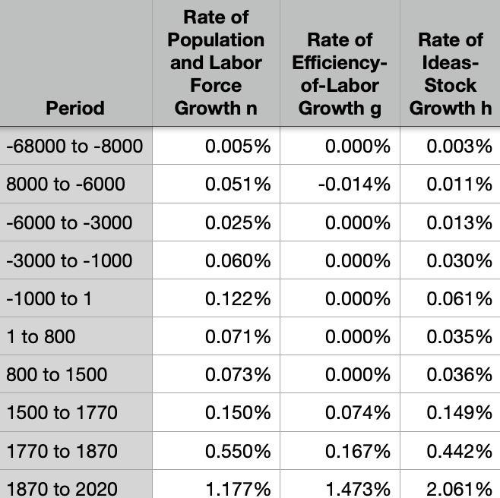
Knowledge & Resources
Why pre-1870 poverty?:
Overwhelmingly: Malthusian factors
Population outran means of subsistence produced by limited resources & slowly-growing technological knowledge
Why was technological knowledge slowly growing?
Few heads?
Entrepreneurship directed toward exploitation?
Absence of routinization?
The industrial research lab and the modern corporation
5:30 of audio in this slide
Notes:
Humans have been inventive as long as there have been humans. Technological advance has rarely stopped. The windmills, dikes, fields, crops, and animals of Holland in 1700 made the economy of its countryside very different indeed from the thinly-farmed marshes of 700. The ships that docked at the Chinese port of Canton had much greater range and the commodities loaded on and off them had much greater value in 1700 than in 800. And both commerce and agriculture in 800 was far advanced in its technology beyond that of the first civilizations to have literacy of -3000 or so.
But before our age, back in the pre-industrial Agrarian-Age, technological progress led to little visible change over one or even several lifetimes; and little growth in typical living standards even over centuries or millennia.
From the standpoint of -6000—possibly able to make felt but not to spin or weave, and probably not yet reliably able to turn barley porridge into beer—the technologies of the year 1500, the Ming pottery or the Portuguese caravel or the wet-cultivation rice seedling, are very impressive. But this growth took enormous spans of time for the invention. And so the pace was very slow: 0.02% per year for the entire span years from 1 to 1500—that is only 0.5% over an average 25-year lifetime of that age.
And did greater knowledge about technology and human organization surely led life in 1500 to be much sweeter than it had been in the year 1? It turns out not. The human population grew at an average rate of 0.06% per year from 1 to 1500. While the elite lived far better in 1500, typical human peasants and craftsmen lived little or no better than their predecessors.
Agrarian Age humans were desperately poor: a subsistence-level society. On average 2.03 children per mother survived to reproduce. A typical woman (who was not in the 1/7 who died in childbirth or the additional ⅕ who died before her children were grown) spent perhaps 20 years eating for two: nine pregnancies, six live births, three children surviving to age five, and the life expectancy at birth of her children under and perhaps well under 30. Keeping your children from dying is the first and highest goal of every parent. Humanity in the Agrarian Age could not do so.
That is an index of how much pressure from material want humanity found itself under.
Then come the three modern watersheds. The ice started to break after 1500. The pace of inventions and innovation sped up. That was the first. Then, starting around 1870, same the second watershed. We call the century before 1870 the “Industrial Revolution” for a reason. By 1870 our heroic-assumptions index of the value of knowledge stood at 16: more than three times its value of 1500. But there were then 1.3 billion people alive, and so farm sizes were only ⅖ as large as they had been in 1500. The bulk of the human population was still in or on the edge of the extreme poverty—living on $2.50 a day or less—that the United Nations Millennium Development Project hoped to banish from the world.
It was only around 1870 that we get the third watershed. It was in the Long 20th Century that there came explosion. Our 7.6 billion people today have a global value of knowledge index of 420. The value of knowledge about technology and organization grew at an average rate of 2.1% per year. Since 1870, the technological capability and material wealth of humankind has exploded beyond previous imagining.
Today the typical human family no longer faces as its most urgent and important problem how to acquire for the next year—or the next week—enough food that they were not desperately hungry, enough shelter that they were not wet, and enough clothing (in climates far from the equator at least) that they were not cold.
From the technological-sociological angle, 1870-2016 was primarily the age of the industrial research lab, the associated communities of engineering practice that supercharged economic growth, and the increasing size and competence of the bureaucratic corporations that deployed the fruits of invention.
It was only slightly less the age of globalization: cheap ocean and rail transport that destroyed distance as a cost factor, of those plus the human desire and ability to cross oceans in enormous numbers to seek better lives, and of submarine and land telegraph and later other communications links that allowed us to talk across the world in real time.

Slide 5
Rough Numbers
Quantities:
Probable fall in living standards with the coming of the agrarian age
Typical agrarian age rate of ideas growth of 0.035%/year
Watershed 1: the 1500 commercial revolution—quadrupling of ideas growth to 0.15%/year
Watershed 2: the 1770 industrial revolution—tripling of ideas growth to 0.44%/year
Watershed 3: the 1870 coming of modern economic growth—near-quintupling of ideas growth to 2.1%/year
Only the last banishes the Malthusian Devil…
4:15 of audio in this slide
Notes:
In 1870 the daily wages of an unskilled male worker in London, the city then at the forefront of world economic growth and development, would buy him and his family about 5,000 calories worth of bread each.
That was progress: in 1800 the daily wages would have bought him and his family perhaps 4000 calories, and in 1600 some 3000 calories.
Today the daily wages of an unskilled male worker in London would buy him 2,400,000 wheat calories: nearly 500 times as much.
From the biological-social angle, the wealth creation process of 1870-2016 drove it to be the century in which it ceased to be the case that the typical woman spent twenty years eating for two—pregnant or breastfeeding. Today, it is more like four years. And it was the century in which we stopped watching half our babies die in miscarriages, stillbirths, and infant mortality—and stopped watching more than a tenth of mothers die in childbed.
A few very rough quantitative estimates are useful:
We believe that there was probably a fall in human living standards with the coming of the agrarian age. Back in the gatherer-hunter age, people lived no longer than they did in the agrarian age, and certainly very young children had greater mortality: the mobile gatherer-hunter lifestyle is tough on infants. But back before the invention of agriculture people were buff and swole—about as tall and about as strong as we are. Humans lost about 4 inches in height and skeletons show a great deal of malnutrition throughout the agrarian age.
But the coming of agriculture brings not only malnutrition, it opens a new employment category: that of being a professional thug with a spear. Gatherer-hunters can simply leave the area if thugs with spears try to get them to surrender their foodstuffs. Farmers cannot. Gross inequality, domination, and the state arrive with agriculture as well as malnutrition does.
But agriculture brings greater population density and the possibility of capital accumulation. Two heads are better than one, and when the amount of stuff one can have is no longer limited to what one can easily carry, human ingenuity begins to carry technology forward at a more rapid rate. I think your typical rates of advance of human ideas about technology at 0.035% per year in the agrarian age. That is a doubling of technological knowledge every 2000 years. Glacial: we get a doubling every generation. But it is there.
Then, starting in 1500, we get our three modern watersheds. Around 1500 with the coming of the commercial revolution era we get a quadrupling of the rate of human technological progress to about 0.15% per year—that would be a doubling every 460 years. Around 1770 we get the coming of the industrial revolution era with a further tripling to 0.44% per year—a doubling of technological knowledge every 150 years.
But these are not enough to create a world rich enough and literate enough with women having enough social power for humans to begin to limit their fertility. Confidence that your children will survive and so you should spend time and energy and care giving each of them as much of an advantage for the future as you can requires a rich society with low infant mortality. In a poor society you think your children are likely to die. So you need to have as many as possible if you wish to have some descendants still alive should you reach old age.
The third modern watershed is the 1870 coming of modern economic growth. It sees a further near-quintupling of the rate of human technological progress to 2.1%/year—a doubling every 23 years. This, finally, is enough to set us on the path to fertility restriction, and for the first time to bring us a world in which technological progress is channeled into boosting human living standards rather than consumed and neutralized by growing human numbers.

Slide 6
Let’s Recap: Why Wasn’t the World Richer in 1870?
There was substantial technological progress between the end of agrarian stagnation in 1500 and 1870.
So why didn’t these first and second modern watersheds make a big difference?
Overwhelmingly, because of Malthusian pressures: population growth meant that average farm sizes in 1870 were but 2/5 of what they had been in 1500.
1:00 of audio in this slide
Notes:
Let’s recap: why wasn’t the world richer in 1870?
There was substantial technological progress between the end of agrarian stagnation in 1500 and 1870. So why was the world in 1870 still so poor—with most humans having good reason to fear that it might be difficult to get their 2000 calories a day next year, and many had good reason to fear that it might be difficult to get their 2000 calories a day next week?
Overwhelmingly, because of Malthusian pressures: By 1870 our heroic-assumptions index of the value of knowledge stood at 16: more than three times its value of 1500. But there were then 1.3 billion people alive, and so farm sizes were only ⅖ as large as they had been in 1500.

Slide 7
Let’s Recap: The Long 20th Century’s Economic Revolution
What was its principal source?
Predominantly, the transformation and routinization of invention, via the creation of the industrial research labs to develop and the communities of engineering practice to understand and the corporations to deploy—these were the things that supercharged economic growth
Secondarily, cheap ocean and rail transport that destroyed distance as a cost and brought economies all over the world cheek-by-jowl: this greatly amplified the division of labor, and prosperity depends primarily on a fine division of labor.
Only tertiarily, the existence of a market economy: rapid modern economic growth is not inevitable once you have a stable market economy with secure property rights. But it does help.
And if I were leftier than I were, I would stress the ability to greatly ramp up the rate of exploitation, and so devote much more of society’s production to investment and capital accumulation.
1:20 of audio in this slide
Notes:
let’s recap: the long 20th century’s economic revolution. What was its principal source?
Its principal source was: predominantly, the transformation and routinization of invention, via the creation of the industrial research labs to develop and the communities of engineering practice to understand and the corporations to deploy—these were the things that supercharged economic growth.
Secondarily, cheap ocean and rail transport that destroyed distance as a cost and brought economies all over the world cheek-by-jowl: this greatly amplified the division of labor, and prosperity depends primarily on a fine division of labor.
Only tertiarily, the existence of a market economy: rapid modern economic growth is not inevitable once you have a stable market economy with secure property rights.
And if I were leftier than I am, I would stress the ability to greatly ramp up the rate of exploitation, and so devote much more of society’s production to investment and capital accumulation.

Slide 8
What Is the Average Global Rate of Economic Growth over the Long 20th Century?
What is the single number you should hold in your head?
0.15% per year
1.5% per year.
8% per year.
2.1% per year
None of the above.
1:30 of audio in this slide
Notes:
Let me try to fix a number in your head.
We can construct a very rough estimate of the pace of growth of human technological knowledge about how to manipulate nature and organize ourselves for production.
Back in the agrarian age from -6000 to 1500 or so a typical proportional rate of growth of that index of the value of economically-useful human knowledge was 0.035%/year: a doubling every 2000 years. Such doublings added up: humanity’s technology in 1500 was thus worth about 16 times as much as its technology in -6000.
But there is a word for such slow growth: glacial.
Against that background, what do you think the average global rate of economic ideas growth has been over the 20th century, since 1870, worldwide?
Make your guess.
Did you guess (D), 2.1%/year? If so, you are right.
In the 20th century we have gotten, in a typical year, as much proportional growth in our economically useful technological knowledge about nature and human organization as we got in 60 years back in the agrarian age.
And, of course, we start from a much higher base. Thus the same proportional rate of growth is much, much, much more in terms of absolute growth.

Slide 9
Shadows…
How many people today are still living on less than $2 a day?
70 million
230 million
700 million
2.3 billion
None of the above.
0:45 of audio in this slide
Notes:
You would think that with humanity now having enough wealth and productivity to give everyone at least 15 times the typical agrarian-age Malthusian-poverty standard of living, that poverty as our ancestors knew it would be banished from the earth.
It has not been.
There are now about 7.7 billion people on the earth. How many of them do you think still live on less than $2/day—still live at about the living standard, in material terms, of our preindustrial ancestors?
Have you made your guess?
It is 700 million. One-tenth of humanity has not benefitted from modern economic growth. That is a stunning statement of how unequal our world has become. That is a stunning indictment of our economic-political systems.

Slide 10
Catch Our Breath…
Ask a couple of questions?
Make a couple of comments?
Any more readings to recommend?
<>

